Slide 1



LIFE/work balance
We have started a #LIFEworkbalance campaign and we need your help to complete our LIFE/work balance survey.
We hope to publish the results soon, so please give 15 minutes of your time to help us get a true picture of school life.
Want to be a part of this campaign? Take the survey on our website and share it with your colleagues!
© Classroom Secrets Limited 2019

Slide 2
Year 5 – Summer Block 2 – Properties of Shape – Regular and Irregular Polygons
About This Resource:
This PowerPoint has been designed to support your teaching of this small step. It includes a starter activity and an example of each question from the Varied Fluency and Reasoning and Problem Solving resources also provided in this pack. You can choose to work through all examples provided or a selection of them depending on the needs of your class.
National Curriculum Objectives:
Mathematics Year 5: (5G2b) Distinguish between regular and irregular polygons based on reasoning about equal sides and angles
More Year 5 Properties of Shapes resources.
Did you like this resource? Don’t forget to review it on our website.
© Classroom Secrets Limited 2018

Slide 3
Year 5 – Summer Block 2 – Properties of Shape
Step 8: Regular and Irregular Polygons
© Classroom Secrets Limited 2018

Slide 4
Introduction
Discuss these statements about polygons.
Are they true or false?
True | False
They have 5 or more sides
They are made up of straight lines
They are 3D shapes
They are 2D shapes
They are a closed shape (no gaps)
They can have curved sides
They include open shapes
© Classroom Secrets Limited 2018

Slide 5
Introduction
Discuss these statements about polygons.
Are they true or false?
True | False
They are a closed shape (no gaps)
They are 3D shapes
They include open shapes
They are made up of straight lines
They can have curved sides
They are 2D shapes
They have 5 or more sides
© Classroom Secrets Limited 2018

Slide 6


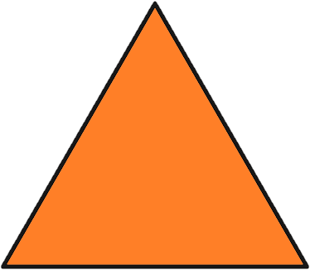
Varied Fluency 1
Circle the regular polygons.
© Classroom Secrets Limited 2018

Slide 7
Varied Fluency 1
Circle the regular polygons.
© Classroom Secrets Limited 2018

Slide 8
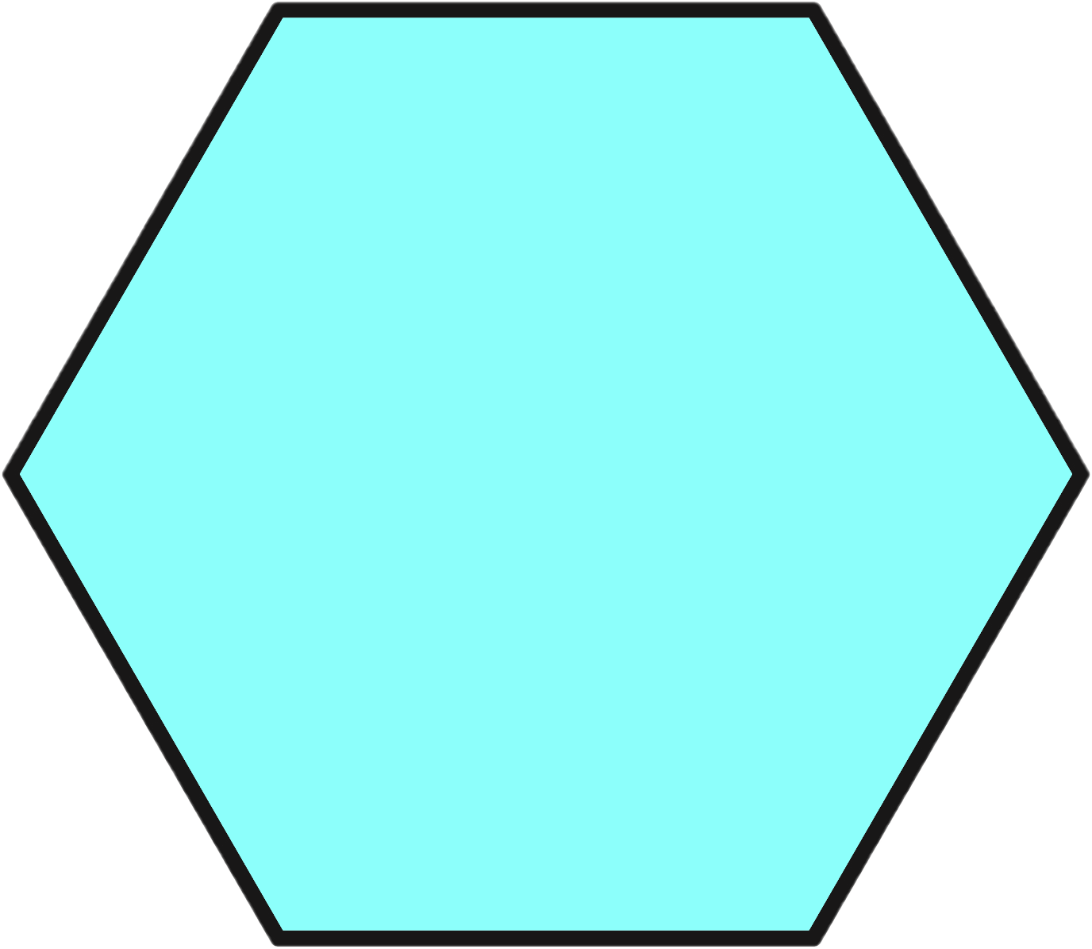
Varied Fluency 2
Identify the name of this shape.
Use a ruler and a protractor to decide whether
it is a regular or irregular polygon.
© Classroom Secrets Limited 2018

Slide 9
Varied Fluency 2
Identify the name of this shape.
Use a ruler and a protractor to decide whether
it is a regular or irregular polygon.
This is a hexagon. It is a regular polygon.
© Classroom Secrets Limited 2018

Slide 10
Varied Fluency 3
This is a regular octagon.
True or false?
© Classroom Secrets Limited 2018

Slide 11
Varied Fluency 3
This is a regular octagon.
True or false?
False.
This is an irregular octagon as there are angles and sides of different lengths.
© Classroom Secrets Limited 2018

Slide 12
Varied Fluency 4
Draw a regular pentagon.
Measure the length of each side and the size of each angle to make sure that they are equal.
© Classroom Secrets Limited 2018

Slide 13
Varied Fluency 4
Draw a regular pentagon.
Measure the length of each side and the size of each angle to make sure that they are equal.
You should have drawn a 5-sided shape.
The sides should all be the same length and all angles should measure 108°.
© Classroom Secrets Limited 2018

Slide 14
Reasoning 1
Has Toni sorted these shapes correctly? Explain your answer.
 | Regular Polygon | Irregular Polygon
Has 5 sides
Not 5 sides
A
B
D
E
F
C
© Classroom Secrets Limited 2018

Slide 15
Reasoning 1
Has Toni sorted these shapes correctly? Explain your answer.
Toni has not sorted the polygons correctly because…
 | Regular Polygon | Irregular Polygon
Has 5 sides
Not 5 sides
A
B
D
E
F
C
© Classroom Secrets Limited 2018

Slide 16
Reasoning 1
Has Toni sorted these shapes correctly? Explain your answer.
Toni has not sorted the polygons correctly because C and E are both irregular polygons as they have sides and angles of different sizes.
 | Regular Polygon | Irregular Polygon
Has 5 sides
Not 5 sides
A
B
D
E
F
C
© Classroom Secrets Limited 2018

Slide 17

Reasoning 2
Jade says:
Is Jade correct? Explain your answer.
A rhombus and a square are both regular polygons because they both have sides of equal length.
© Classroom Secrets Limited 2018

Slide 18
Reasoning 2
Jade says:
Is Jade correct? Explain your answer.
Jade is incorrect…
A rhombus and a square are both regular polygons because they both have sides of equal length.
© Classroom Secrets Limited 2018

Slide 19
Reasoning 2
Jade says:
Is Jade correct? Explain your answer.
Jade is incorrect. A square is a regular polygon as it has sides of equal length and each angle measures 90°.
However, a rhombus may have 4 sides of equal length, but it does not have 4 angles of equal size.
A rhombus and a square are both regular polygons because they both have sides of equal length.
© Classroom Secrets Limited 2018

Slide 20
Problem Solving 1
How many regular polygons can you see in this shape?
© Classroom Secrets Limited 2018

Slide 21
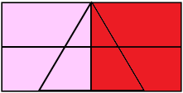
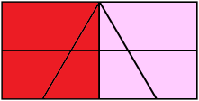
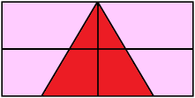
Problem Solving 1
How many regular polygons can you see in this shape?
3 regular polygons (2 regular squares and 1 regular triangle).
© Classroom Secrets Limited 2018

